Slide 1


Slide 2

Introduction to
Data Science
(IT4142E)

Slide 3
Contents
Lecture 1: Overview of Data Science
Lecture 2: Data crawling and preprocessing
Lecture 3: Data cleaning and integration
Lecture 4: Exploratory data analysis
Lecture 5: Data visualization
Lecture 6: Multivariate data visualization
Lecture 7: Machine learning
Lecture 8: Big data analysis
Lecture 9: Capstone Project guidance
Lecture 10+11: Text, image, graph analysis
Lecture 12: Evaluation of analysis results

Slide 4
Plan
Computer Vision and Applications
Digital image / video ?
Basic informations about digital images
histogram, brightness, contrast, color, texture, …
Library : Opencv
Convolution and Filters
noisy remove,
edge detectors
Feature extraction: local and global descriptor

Slide 5
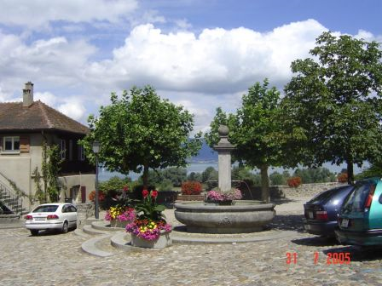
Computer Vision ?
Image Processing
Work with image as a matrix
Input: image ➔ output: image
Help human to examine / modify images
Computer Vision
Make computers understand images and video
Images and video are a source of information on the reality
What kind of scene?
Where are the cars?
How far is the building?
…

Slide 6
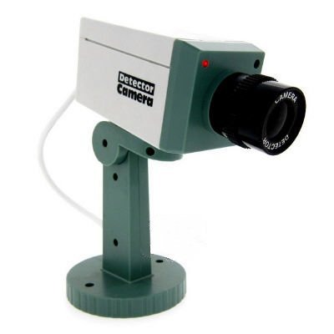
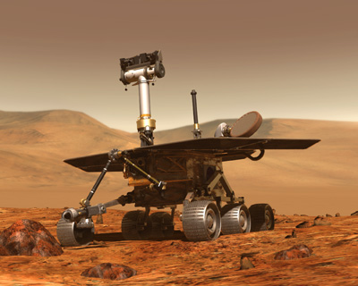
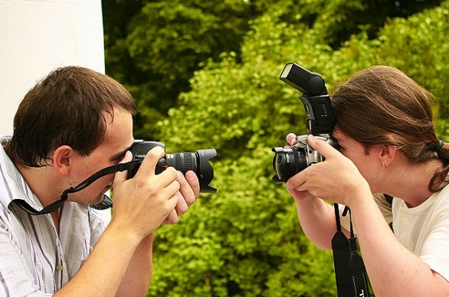
Computer Vision and Applications
Images, video are everywhere
Video, images:
Riche information
Hot topic, especially
When we talk every day
about AI with smart city,
mart home, smart …

Slide 7
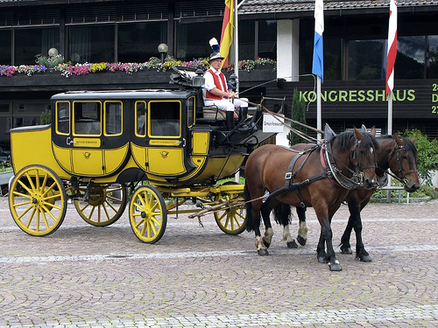
How vision is used now
Understand the image
Animal
Vehicle
head
Four-legged
Mammal
wheel
leg

Slide 8
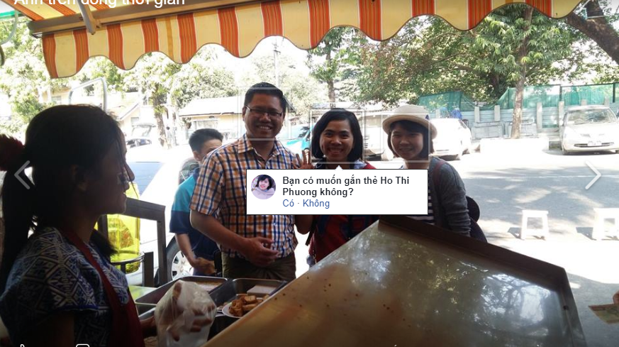
How vision is used now
Understand the image
Facebook's suggestion

Slide 9
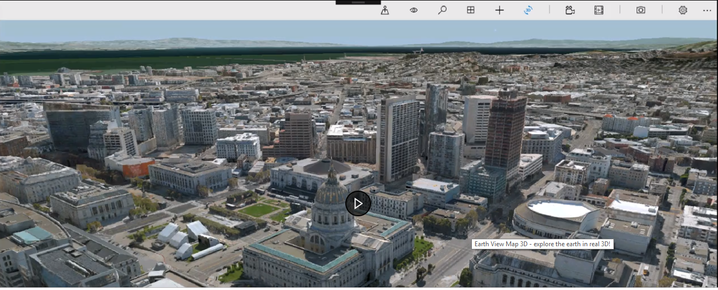
How vision is used now
Earth View, Google earth (3D modeling from lots of 2D images): automatic building generation + hand modeled buildings (Golden Gate bridge or Sydney Opera house)
Microsoft's Virtual Earth

Slide 10
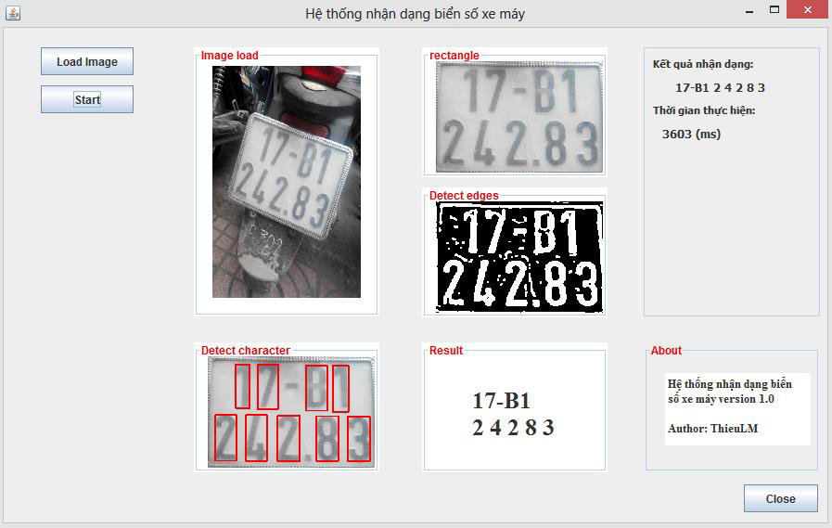

How vision is used now
OCR (Optical character recognition)
Technology to convert scanned docs to text: each scanner came with an OCR software
Digit recognition, AT&T labs
http://yann.lecun.com/exdb/lenet/
Licence plate detection
and character recognition

Slide 11
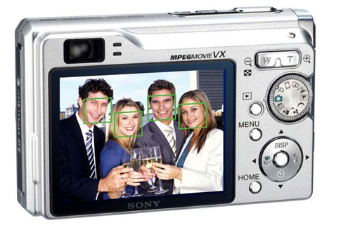
How vision is used now
Face detection: most of camera detect faces
Main raison is focus, enables smart cropping
Source: Derek Hoiem, Computer vision, CS 543 / ECE 549, University of Illinois

Slide 12
How vision is used now
Smile detection: smart camera
Camera can automatically trip the shutter at the right instant to catch the perfect expression
Source: Derek Hoiem, Computer vision, CS 543 / ECE 549, University of Illinois

Slide 13
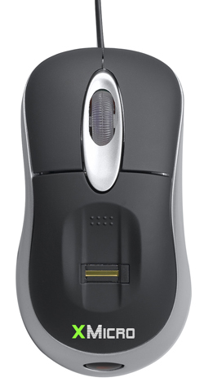
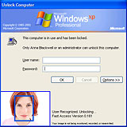
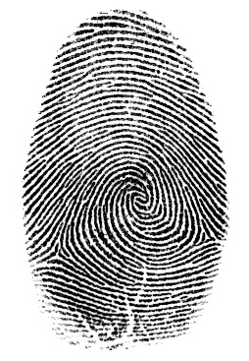

How vision is used now
Login without a password, but with biometrics (fingerprint, iris, face,…
Fingerprint scanners on many new laptops, other devices
Face recognition systems now beginning to appear more widely http://www.sensiblevision.com/
Source: Derek Hoiem, Computer vision, CS 543 / ECE 549, University of Illinois
Notes:
Biometrics

Slide 14
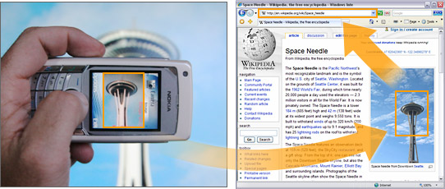
How vision is used now
Object recognition (on mobile phones)
Point & Find, Nokia
Google Goggles
Source: Derek Hoiem, Computer vision, CS 543 / ECE 549, University of Illinois

Slide 15
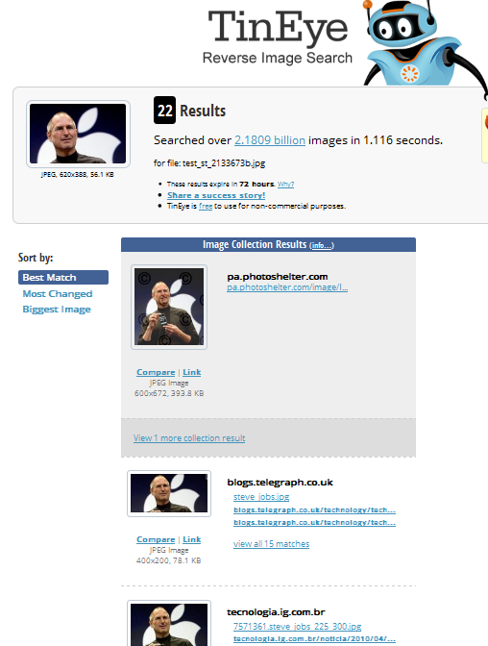
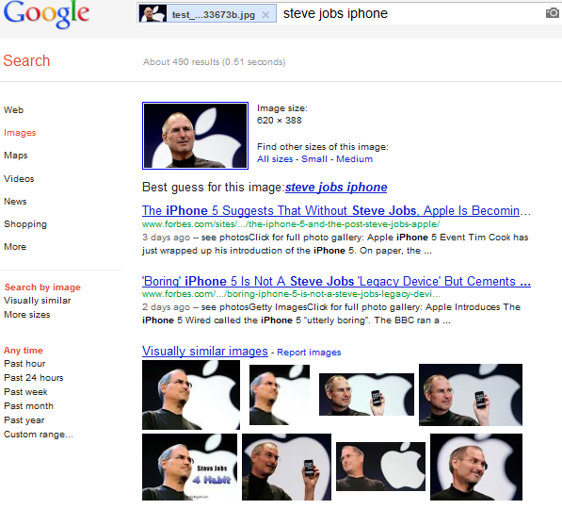
How vision is used now
Content-based image retrieval

Slide 16
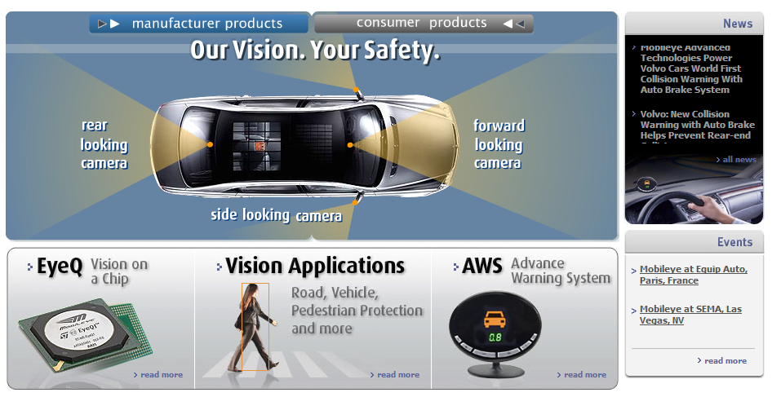
How vision is used now
Smart cars → autonomous vehicles
Mobileye: vision systems currently in many cars
“In mid 2010 Mobileye will launch a world's first application of full emergency braking for collision mitigation for pedestrians where vision is the key technology for detecting pedestrians
Source: Derek Hoiem, Computer vision, CS 543 / ECE 549, University of Illinois

Slide 17
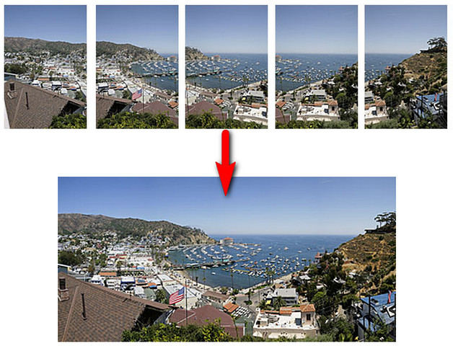
How vision is used now
Panorama stitching:
Source:http://miseaupoint.org/blog/en/wp-content/uploads/2014/01/photo_stitching.jpg

Slide 18
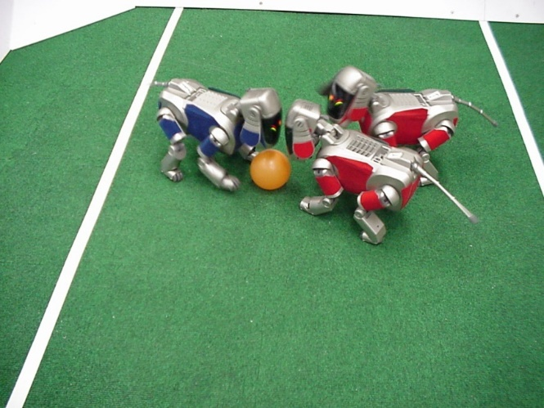
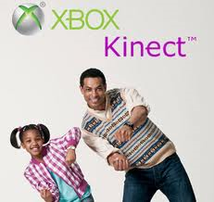
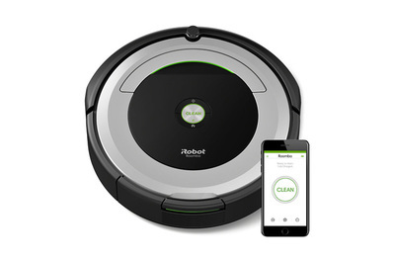
How vision is used now
Games / robots:
http://www.robocup.org/
Vision-based interaction game
(Microsoft's Kinect)
Robot vacuum cleaner

Slide 19
How vision is used now
To learn more about vision applications and companies, please visite D.Lowe 's note:
https://www.cs.ubc.ca/~lowe/vision.html

Slide 20
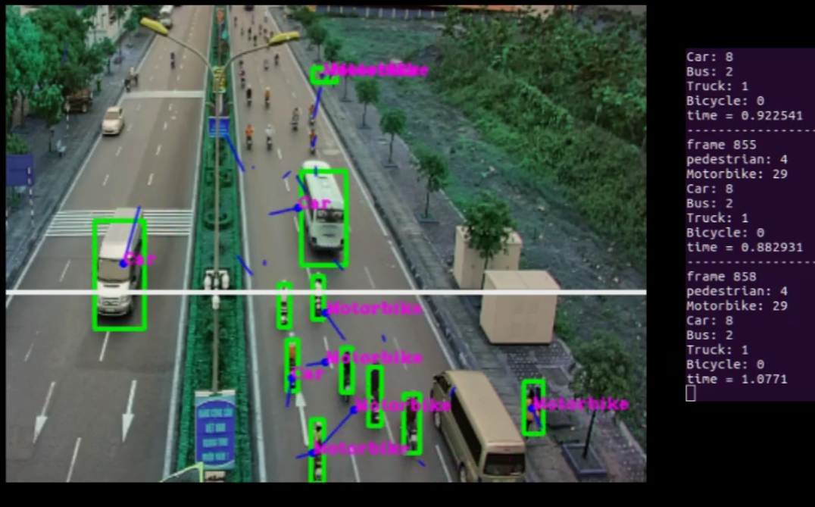
Some topics in CV
Surveillance Cameras:
Counting number of clients in shop/restaurant
Detecting abnormal behaviors
Measuring customer's satisfaction
Object tracking: Someone ran a red light?
Object classification / detection
Face / body/ eyes detection
Action recognition
Defect detection
Image annotation / labeling
Text detection and recognition
Card visit reader
3D object construction from 2D images

Slide 21
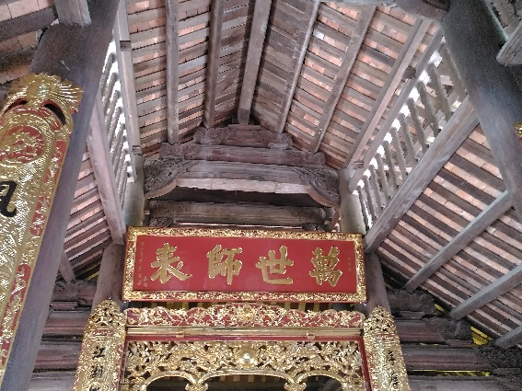
What we will talk about?
2 types information we would like to extract from images:
Matrix 3D information
Semantic Information
3D building?
Where is it?
Text in the picture,
what does it means?
How to represent
the content of images ?
Are there person
in the picture?
Feature extraction
Learning
Pre-processing
Model
Deep Learning

Slide 22
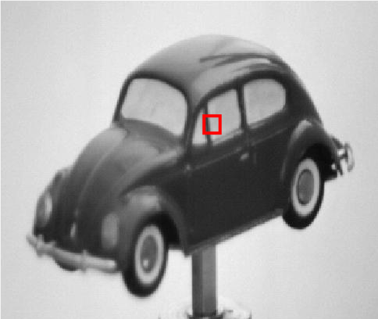
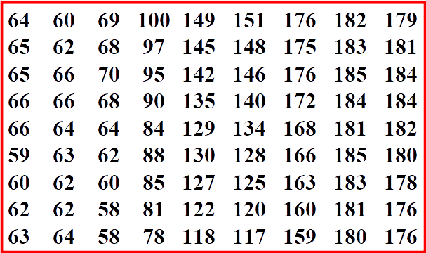
Digital images ?
What we can see on the picture?
A car?
What does the machine see?
Image is a matrix of pixels
Image N x M : N xM matrix
1 pixel (gray levels):
A intensity value: 0-255
Black: 0
White: 255

Slide 23
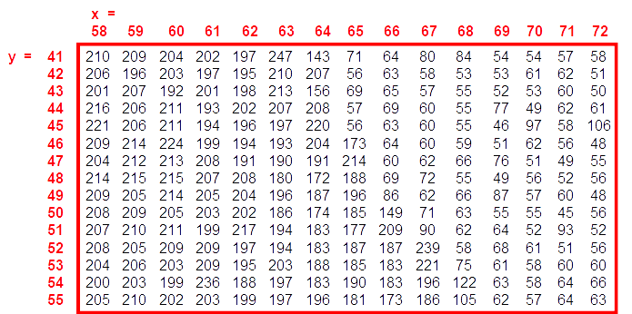
Digital images ?
x
For an image I
Index (0,0): Top left corner
I(x,y): intensity of pixel at
the position (x,y)
y

Slide 24
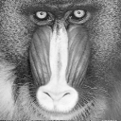
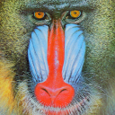
Digital images ?
Principal type of images
Binary image:
I(x,y) ∈ {0 , 1}
1 pixel: 1 bit
Gray image:
I(x,y) ∈ [0..255]
1 pixel: 8 bits (1 byte)
Color image
I_{R}(x,y), I_{G}(x,y) I_{B}(x,y) ∈ [0..255]
1 pixel: 24 bits (3 bytes )
Other : multi-spectre, depth image,…

Slide 25
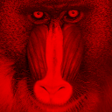
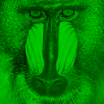
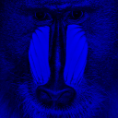
Color image in RGB space
It exists other color spaces:
Lab, HSV, …

Slide 26
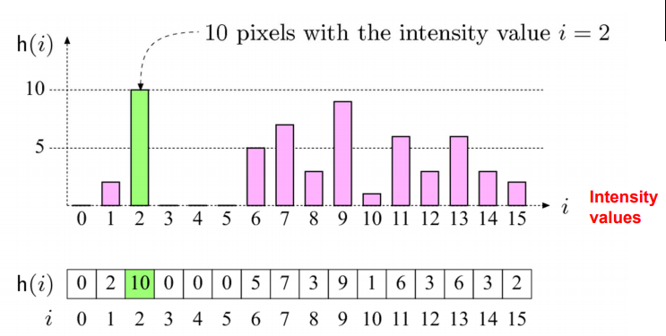
Image histogram
Histogram is a graphical representation of the repartition of colours among the pixels of a numeric image.

Slide 27
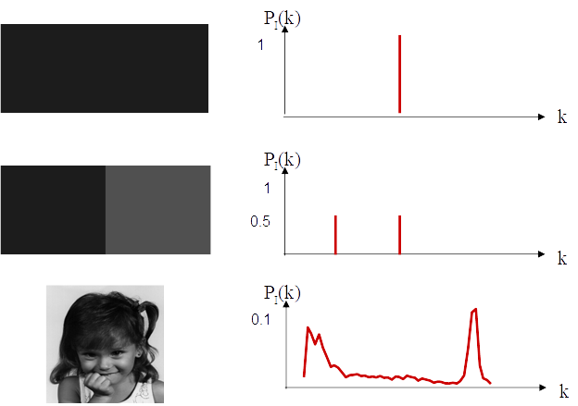
Image histogram
Histogram
Should be normalized by dividing all elements to total number of pixels in the image

Slide 28
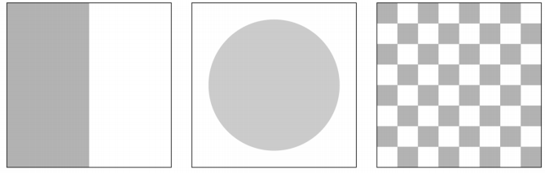
Image histogram
Histogram
Only statistic information
No indication about the location of pixel (no spatial information)
Different image can have the same histogram

Slide 29
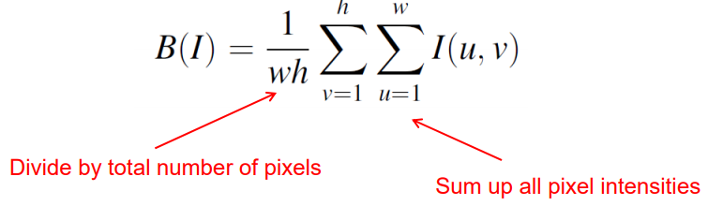
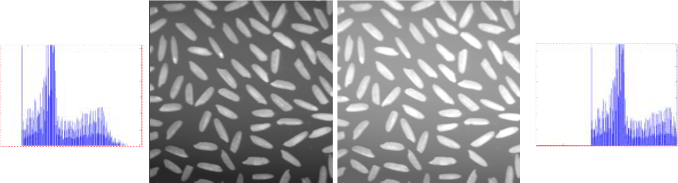
Image Brightness
Brightness of a grayscale image is the average intensity of all pixels in an image
refers to the overall lightness or darkness of the image

Slide 30
Contrast
The contrast of a grayscale image indicate how easily object in the image can be distinguished
Many different equations for contrast exist
Standard deviation of intensity values of pixels in the image
Difference between intensity value maximum et minimum

Slide 31
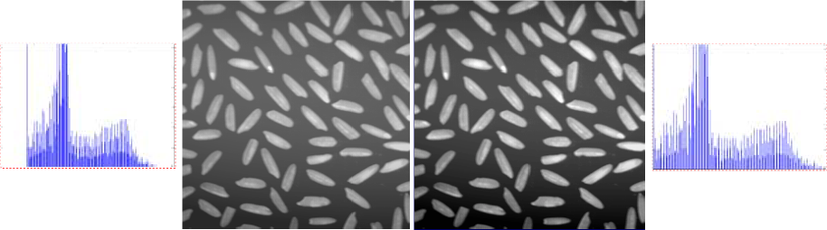
Contrast
Contrast vs histogram
Notes:
Contrast is a measure of the difference in brightness between light or dark areas in a scene.
Broad histograms reflect a scene with significant contrast, whereas narrow histograms reflect less contrast and may appear flat or dull (mờ)

Slide 32
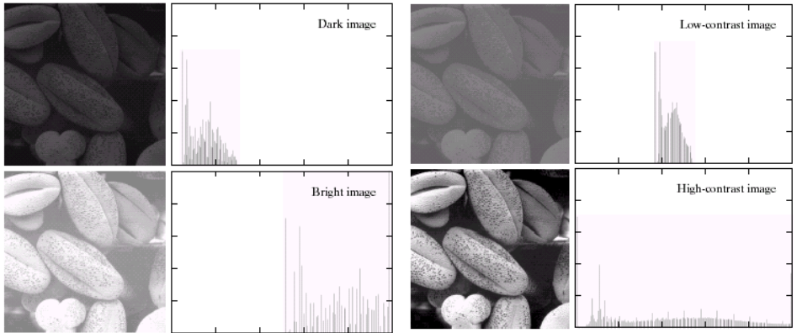
Examples

Slide 33
Contrast Enhancement
Modify pixel intensities to obtain higher contrast
There are several methods:
Linear stretching of intensity range:
Linear transform
Linear transform with saturation
Piecewise linear transform
Non-linear transform (Gama correction)
Histogram equalization (Cân bằng histogram)

Slide 34
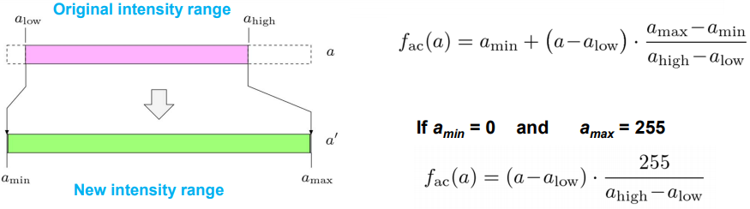
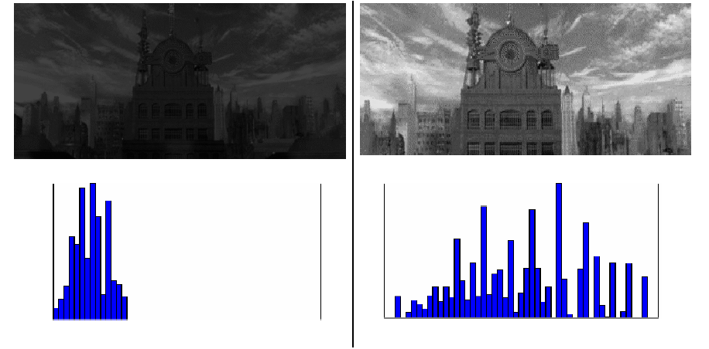
Linear stretching
Linear transform
Notes:
cv2.equalizeHist(img)

Slide 35
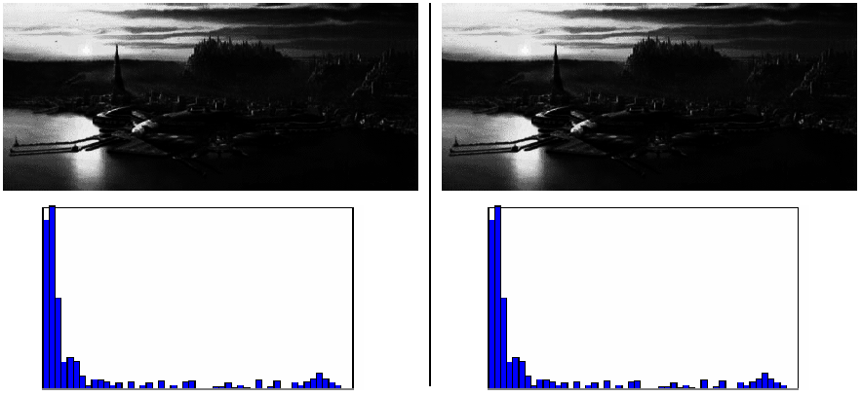
Linear stretching
No efficace?

Slide 36
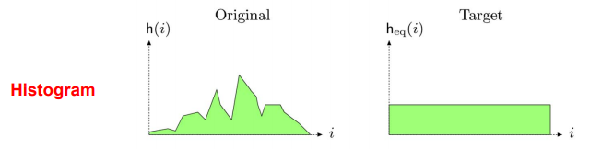
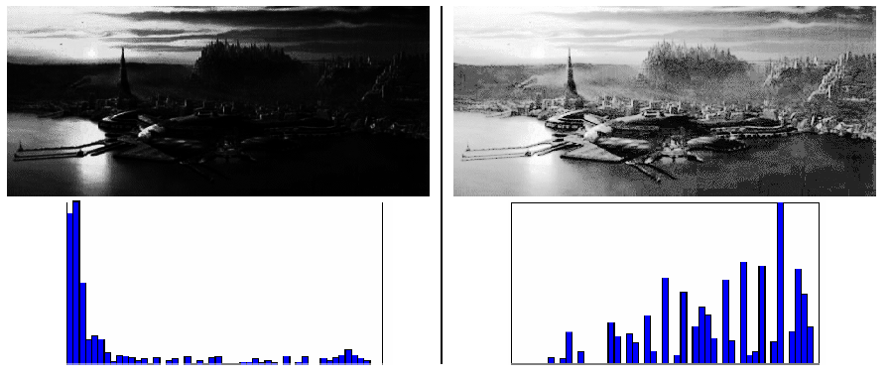
Histogram equalization
Change histogram of modified image into uniform distribution
No parameters. OpenCV:cv2.equalizeHist(img)

Slide 37
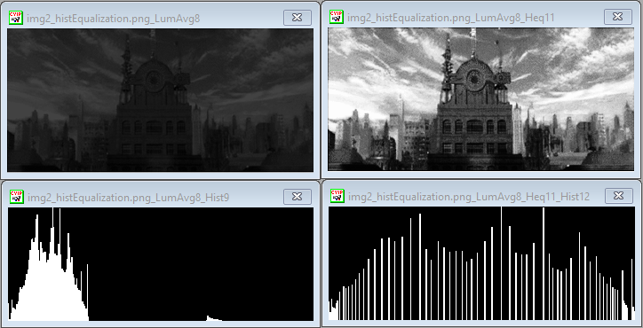
Histogram equalization

Slide 38
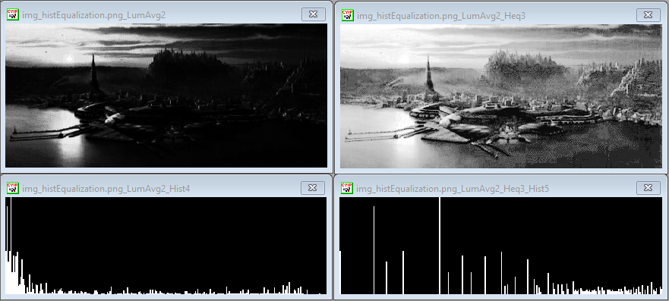
Histogram equalization

Slide 39
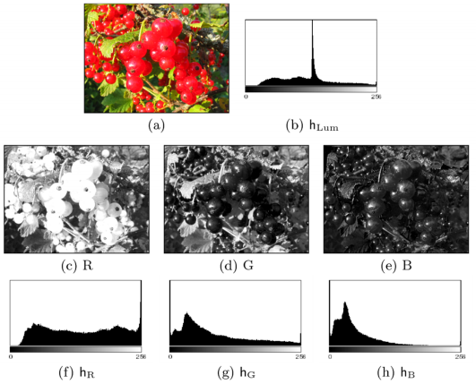
Color Image histogram
Intensity histogram:
Convert color image to grayscale
=> Compute histogram of gray scale image
Individual Color Channel Histograms:
3 histograms for (R,G,B)
3D histogram:
a color identified by 3 values. Not usually because of big elements
Source: https://web.cs.wpi.edu/~emmanuel

Slide 40
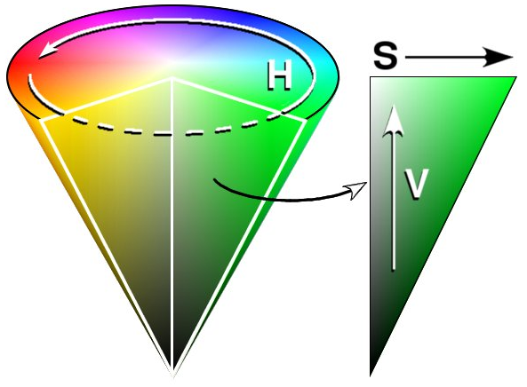
HSV (Hue – Saturation- Value)
The Hue-Saturation-Value (HSV) color space is useful for segmentation and recognition
Non-linear conversion
Visual representation of colors
We identify for a pixel:
The pixel intensity (value)
The pixel color (hue + saturation)
RGB does not have this seperation

Slide 41
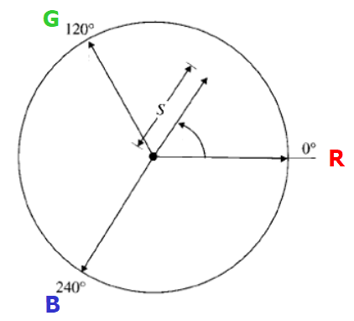
HSV (Hue – Saturation- Value)
Hue (H) is coded as an angle between 0 and 360
Saturation (S) is coded as a radius between 0 and 1
S = 0 : gray
S = 1 : pure color
Value (V) = MAX (Red, Green, Blue)

Slide 42
HSV (Hue – Saturation- Value)
If we know the color of the object we are looking for, we can model it using a hue interval
Take care, because it is an angle (periodic value)
Hue < 60° means nothing
Is 350° smaller or bigger than 60°?
Define an interval: 350° < Hue < 60° (for example)
This interval is valid if Saturation > threshold (otherwise gray level)
This is independant of Value , which is more sensible to light conditions

Slide 43
Lab color space
The Lab system (sometimes L*a*b*) is based on a study from human vision
independant from all technologies
presenting colors as seen by the human eyes
Colors are defined using 3 values
L is the luminance, going from 0% (black) to 100% (white)
a* represents an axis going from green (negative value, -127) to red (positive value, +127)
b* represents an axis going from blue (negative value, -127) to yellow (positive value,+127)
Notes:
https://docs.opencv.org/3.3.0/de/d25/imgproc_color_conversions.html

Slide 44
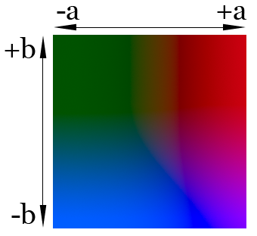
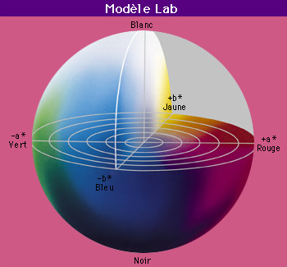
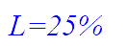


Lab color space

Slide 45


Color space vs. illumination conditions
collected 10 images of the cube under varying illumination conditions
separately cropped every color to get 6 datasets for the 6 different colors
Compute the density plot: Check the distribution of a particular color say, blue or yellow in different color spaces. The density plot or the 2D Histogram gives an idea about the variations in values for a given color
Changes in color due to varying Illumination conditions
Source: Vikas Gupta, Learn OpenCV

Slide 46

Color space vs. illumination conditions
Similar illumination: very compact
Fig.: Density Plot showing the variation of values in color channels for 2 similar bright images of blue color
Source: Vikas Gupta, Learn OpenCV

Slide 47

Color space vs. illumination conditions
Similar illumination: very compact
Fig.: Density Plot showing the variation of values in color channels for 2 similar bright images of yellow color
Source: Vikas Gupta, Learn OpenCV

Slide 48

Color space vs. illumination conditions
Different illumination:
Fig.: Density Plot showing the variation of values in color channels under varying illumination for the blue color
Source: Vikas Gupta, Learn OpenCV

Slide 49

Color space vs. illumination conditions
Different illumination:
Fig.: Density Plot showing the variation of values in color channels under varying illumination for the yellow color
Source: Vikas Gupta, Learn OpenCV
Notes:
Ideally, we want to work with a color space with the most compact / concentrated density plot for color channels.
The density plots for RGB blow up drastically. This means that the variation in the values of the channels is very high and fixing a threshold is a big problem. Fixing a higher range will detect colors which are similar to the desired color ( False Positives ) and lower range will not detect the desired color in different lighting ( False Negatives ).
In HSV, since only the H component contains information about the absolute color. Thus, it becomes my first choice of color space since I can tweak just one knob ( H ) to specify a color as compared to 2 knobs in YCrCb ( Cr and Cb ) and LAB ( A and B ).
Comparing the plots of YCrCb and LAB shows a higher level of compactness in case of LAB. So, next best choice for me becomes the LAB color space.

Slide 50
Color space vs illumination conditions
Different illumination:
RGB space: the variation in the value of channels is very hight
HSV: compact in H. Only H contains information about the absolute color ➔ a choix
YCrCb, LAB: compact in CrCb and in AB
Higher level of compactness is in LAB
Convert to other color spaces (OpenCV):
cvtColor(bgr, ycb, COLOR_BGR2YCrCb);
cvtColor(bgr, hsv, COLOR_BGR2HSV);
cvtColor(bgr, lab, COLOR_BGR2Lab);
Notes:
Ideally, we want to work with a color space with the most compact / concentrated density plot for color channels.
The density plots for RGB blow up drastically. This means that the variation in the values of the channels is very high and fixing a threshold is a big problem. Fixing a higher range will detect colors which are similar to the desired color ( False Positives ) and lower range will not detect the desired color in different lighting ( False Negatives ).
In HSV, since only the H component contains information about the absolute color. Thus, it becomes my first choice of color space since I can tweak just one knob ( H ) to specify a color as compared to 2 knobs in YCrCb ( Cr and Cb ) and LAB ( A and B ).
Comparing the plots of YCrCb and LAB shows a higher level of compactness in case of LAB. So, next best choice for me becomes the LAB color space.
cvtColor(bgr, ycb, COLOR_BGR2YCrCb);
cvtColor(bgr, hsv, COLOR_BGR2HSV);
cvtColor(bgr, lab, COLOR_BGR2Lab);
https://docs.opencv.org/3.3.0/de/d25/imgproc_color_conversions.html

Slide 51
Spatial convolution
Image filtering : For each pixel, compute function of local neighborhood and output a new value
Same function applied at each position
Output and input image are typically the same size
Convolution : Linear filtering, function is a weighted sum/difference of pixel values
I' = I * K
Really important!
Enhance images: Denoise, smooth, increase contrast, etc.
Extract information from images:
Texture, edges, distinctive points, etc.
Detect patterns
Template matching
Notes:
Convolution is correlation with the filter rotated 180 degrees. This makes no difference, if the filter is symmetric, like a Gaussian, or a Laplacian. But it makes a whole lot of difference, when the filter is not symmetric, like a derivative.
The reason we need convolution is that it is associative, while correlation, in general, is not. To see why this is true, remember that convolution is multiplication in the frequency domain, which is obviously associative. On the other hand, correlation in the frequency domain is multiplication by the complex conjugate, which is not associative.
The associativity of convolution is what allows you to "pre-convolve" the filters, so that you only need to convolve the image with a single filter. For example, let's say you have an image ff, which you need to convolve with gg and then with hh. f∗g∗h=f∗(g∗h)f∗g∗h=f∗(g∗h). That means you can convolve ggand hh first into a single filter, and then convolve ff with it. This is useful, if you need to convolve many images with gg and hh. You can pre-compute k=g∗hk=g∗h, and then reuse kk multple times.
So if you are doing template matching, i. e. looking for a single template, correlation is sufficient. But if you need to use multiple filters in succession, and you need to perform this operation on multiple images, it makes sense to convolve the multiple filters into a single filter ahead of time.

Slide 52

Spatial convolution
Mask (kernel)
Original image
Filtered image

Slide 53

Spatial convolution
New value of a pixel(i,j) is a weighted sum of its neigbors
K: convolution kernel, mask, filter, …
Notes:
Flip the kernel both horizontally and vertically (filter rotated 180 degrees).
(As our selected kernel is symetric, the flipped kernel is equal to the original.)
Put the center of kernel at each pixel (i,j) of the image. Then each element of the kernel will stand on top of an element of the image matrix
Multiply each element of the kernel with its corresponding element of the image matrix (the one which is overlapped with it)
Sum up all product outputs and put the result at the same position in the output matrix as the center of kernel in image matrix.

Slide 54

Spatial convolution
New value of a pixel(i,j) is a weighted sum of its neigbors
Source: http://machinelearninguru.com
Notes:
Flip the kernel both horizontally and vertically (filter rotated 180 degrees).
(As our selected kernel is symetric, the flipped kernel is equal to the original.)
Put the center of kernel at each pixel (i,j) of the image. Then each element of the kernel will stand on top of an element of the image matrix
Multiply each element of the kernel with its corresponding element of the image matrix (the one which is overlapped with it)
Sum up all product outputs and put the result at the same position in the output matrix as the center of kernel in image matrix.

Slide 55

Spatial convolution
I' = I * K

Slide 56

Spatial convolution
I' = I * K

Slide 57

Spatial convolution
I' = I * K

Slide 58




Spatial convolution
Border problem?
Zero padding in the input matrix
reflect across edge:
f(-x,y) = f(x,y)
f(-x,-y) = f(x,y)
…
Notes:
For the pixels on the border of image matrix, some elements of the kernel might stands out of the image matrix and therefore does not have any corresponding element from the image matri

Slide 59


Spatial convolution
Source: http://machinelearninguru.com

Slide 60
Some kernels
2D spatial convolution
is mostly used in image processing for feature extraction
And is also the core block of Convolutional Neural Networks (CNNs)
Each kernel has its own effect and is useful for a specific task such as
blurring (noise removing),
sharpening,
edge detection,
…..

Slide 61
Some kernels
0 | 0 | 0
0 | 1 | 0
0 | 0 | 0
*
Original image
Filtered image
(no change)
0 | 0 | 0
1 | 0 | 0
0 | 0 | 0
*
Original image
Filtered image
(shifted left by 1 pixel)
Source: David Lowe

Slide 62


Some kernels
Box filter (mean filter):
Replace each pixel with an average of its neigborhood
Achieve smoothing effect
Original image
Filtered image
with box size 5x5
Filtered image
with box size 11x11

Slide 63

Some kernels
Gaussian filter
0.003 | 0.013 | 0.022 | 0.013 | 0.003
0.013 | 0.059 | 0.097 | 0.059 | 0.013
0.022 | 0.097 | 0.159 | 0.097 | 0.022
0.013 | 0.059 | 0.097 | 0.059 | 0.013
0.003 | 0.013 | 0.022 | 0.013 | 0.003
Gaussian filter with size 5 x5 , sigma =1
Gaussian function in 3D
Rule for Gaussian filter:
set filter half-width to about 3σ
Gaussian image

Slide 64

Some kernels
Gaussian filter:
Low-pass filter: Remove high-frequency component from the image
Image becomes more smooth
Better than mean filter
Convolution with itself is an other Gaussian
Repeat the conv. With small-width kernel => get the same result as larger-width kernel would have.
Convolving 2 times with Gaussian kernel of width σ is the same as convolving once with kernel of width σ$\sqrt{2}$ : I*G_{σ}*G_{σ} = I * G _{σ}$\sqrt{2}$
Separable filter: The 2D Gaussian can be expressed as the product of 2 functions : one function of x and a function of y:
G _{σ}(x,y) = G _{σ}(x).G _{σ}(y)

Slide 65

Some kernels
Gaussian filter
Original image
Filtered image
with box size 5x5
Filtered image
with box size 11x11

Slide 66


Some kernels
Sobel
*
Vertical Edge
(absolute value)

Slide 67

Some kernels
Sobel
*
Horizontal Edge
(absolute value)

Slide 68

Edge detection
Edges are corresponding to:
Maximums of the first derivative
Zero-crossing in the second derivative

Slide 69
Edge detection with first derivatives
Compute the convolution between the image and the first derivatives kernels
Kernels: Sobel, Prewitt, Robert
Implemented in OpenCV library
Find local extrema
Edge composed of pixels having maximum/minimum value of the first derivatives of image
Can use a threshold to detect edge rapidly
Can make several steps to obtain the optimal edge: Canny detector (implemented in OpenCV)

Slide 70




Edge detection with first derivatives
Filters used to compute the first derivatives of image
Robert
Prewitt
less sensitive to noise
Smoothing with mean filter, then compute1st derivative
Sobel:
less sensitive to noise
Smoothing with gaussian, then computing1st derivative
y
x

Slide 71


Edge detection with first derivatives

Slide 72
Image derivatives
1st derivatives :
I *
I_{x}
First derivative of image with respect to x
I *
I_{y}
First derivative of image with respect to y
Image gradient

Slide 73


Image gradient
An image gradient is a directional change in the intensity or color in an image
For each pixel in the image: Gx, Gy
Form a gradient vector (Gx, Gy) :
Important information to describe the image content
Gradient Magnitude = $\sqrt{{\text{(}\text{Gx}\text{)}}^{2}\text{ + }({\text{Gy}\text{)}}^{2}}$ ≈|Gx| + |Gy|
Gradient Direction = arctan(Gy/Gx)
Blue lines represent the gradient direction: from brightest to darkest

Slide 74
Edge detection with second derivatives
Compute the second derivative
Convolution images with the Laplacian filter
Find zero-crossing

Slide 75

Laplacian filter - Second derivative
Discrete approximations for the Laplacian function
One convolution matrix

Slide 76
Feature extraction
Two types of features are extracted from the image:
local and global features (descriptors)
Global features
Describe the image as a whole to the generalize the entire object
Include contour representations, shape descriptors, and texture features
Examples: Invariant Moments (Hu, Zernike), Histogram Oriented Gradients (HOG), PHOG, and Co-HOG,...
Local feature:
the local features describe the image patches (key points in the image) of an object
represents the texture/color in an image patch
Examples: SIFT, SURF, LBP, BRISK, MSER and FREAK, …

Slide 77




Feature extraction
Global features
256 bins intensity histogram
Pyramid Histogram of Oriented Gradients
16 bins intensity histogram
Source:http://www.robots.ox.ac.uk/~vgg/research/caltech/phog.html

Slide 78
Feature extraction
Global features : ? PCA (chưa được giới thiệu ở phần ML) hoặc tìm 1 đặc trung khác đã có trong OpenCV để sv dễ theo dõi

Slide 79



Feature extraction
Local features: how to determine image patches / local regions
Dividing into patches with regular grid
Keypoint detection
Image segmentation
Without knowledge about
image content
Based on the content of image

Slide 80
Feature extraction
Image segmentation
Thresholding
Split and merge
Region growing
Watershed
…

Slide 81


Feature extraction
Keypoint detectors:
DoG /SIFT detector
Harris corner detector
Moravec
…
Local features: computed in local regions associated to each keypoints:
SIFT,
SURF(Speeded Up Robust Features),
PCA-SIFT
LBP, BRISK, MSER and FREAK, …

Slide 82



Feature extraction : DoG/SIFT detector
A SIFT keypoint : {x, y, scale, dominant orientation}
Source: Distinctive Image Features from Scale-Invariant Keypoints – IJCV 2004

Slide 83
Feature extraction : Good feature?
Compact
Invariant to
geometric transformation
Camera viewpoint
Lighting condition
Best performant local feature: SIFT (David Lowe)

Slide 84



Feature extraction : SIFT feature
Blur the image
using the scale of
the keypoint
(scale invariance)
Compute orientation
histogram in 8
directions over 4x4
sample regions
Compute gradients in
respect to the keypoint
orientation(rotation
invariance)
Source: Distinctive Image Features from Scale-Invariant Keypoints – IJCV 2004
http://campar.in.tum.de/twiki/pub/Chair/TeachingWs13TDCV/feature_descriptors.pdf

Slide 85
Other detectors and descriptors
Popular features: SURF, HOG, SIFT
http://campar.in.tum.de/twiki/pub/Chair/TeachingWs13TDCV/feature_descriptors.pdf
Summary some local features:
http://www.cse.iitm.ac.in/~vplab/courses/CV_DIP/PDF/Feature_Detectors_and_Descriptors.pdf

Slide 86
Feature extraction : OpenCV
SIFT & SURF:
Patented algorithms
They are free to use fro academic / research purposes
You should technically be getting permission to use them in commercial applications
From OpenCV 3.0, patented algorithms are
removed from standard package,
putted into non-free module (opencv-contrib, not installed by default)
Free alternatives to sift, surf:
ORB (Oriented FAST and Rotated Brief)
BRIEF, BRISK, FREAK, KAZE and AKAZE
Notes:
https://docs.opencv.org/3.4/db/d27/tutorial_py_table_of_contents_feature2d.html
The algorithms and associated implementations in opencv_contrib are not installed by default and you need to explicitly enable them when compiling and installing OpenCV to obtain access to them.

Slide 87
Feature extraction : OpenCV
SIFT
sift.detect() function finds the keypoint in the images
sift.compute() which computes the descriptors from the keypoints
sift = cv.xfeatures2d.SIFT_create()
kp = sift.detect(gray,None)
kp,des = sift.compute(gray,kp)
Find keypoints and descriptors in a single step sift.detectAndCompute()
sift = cv.xfeatures2d.SIFT_create()
kp, des = sift.detectAndCompute(gray,None)
https://docs.opencv.org/3.4/da/df5/tutorial_py_sift_intro.html
SURF: similar
Notes:
https://docs.opencv.org/3.4/db/d27/tutorial_py_table_of_contents_feature2d.html
The algorithms and associated implementations in opencv_contrib are not installed by default and you need to explicitly enable them when compiling and installing OpenCV to obtain access to them.

Slide 88

Feature extraction : OpenCV
SURF: similar
>>> img = cv.imread('fly.png',0)
# Create SURF object. You can specify params here or later.
# Here I set Hessian Threshold to 400
>>> surf = cv.xfeatures2d.SURF_create(400)
# Find keypoints and descriptors directly
>>> kp, des = surf.detectAndCompute(img,None)
>>> len(kp)
699
https://docs.opencv.org/3.4/df/dd2/tutorial_py_surf_intro.html
Notes:
https://docs.opencv.org/3.4/db/d27/tutorial_py_table_of_contents_feature2d.html
The algorithms and associated implementations in opencv_contrib are not installed by default and you need to explicitly enable them when compiling and installing OpenCV to obtain access to them.

Slide 89



Origin: Bag-of-words models
Orderless document representation: frequencies of words from a dictionary Salton & McGill (1983)
US Presidential Speeches Tag Cloud http://chir.ag/phernalia/preztags/

Slide 90


Bags of features for object recognition
Works pretty well for image-level classification and for recognizing object instances
face, flowers, building
Csurka et al. (2004), Willamowski et al. (2005), Grauman & Darrell (2005), Sivic et al. (2003, 2005)

Slide 91





Bag of features: outline
Extract features
Learn “visual vocabulary”
Quantize features using visual vocabulary
Represent images by frequencies of “visual words”
Notes:
https://answers.opencv.org/question/17460/how-to-use-bag-of-words-example-with-brief-descriptors/
https://docs.opencv.org/master/d2/d6b/classcv_1_1BOWImgDescriptorExtractor.html
https://docs.opencv.org/master/de/d24/group__features2d__category.html
https://machinelearningknowledge.ai/image-classification-using-bag-of-visual-words-model/

Slide 92
References
CVIP tool to explore the power of computer processing of digital images: Many methods in image processing and computer vision have been implemented
https://cviptools.ece.siue.edu/
Library: OpenCV, with C/C++, Python and Java interfaces. OpenCV was designed for computational efficiency and with a strong focus on real-time application: https://opencv.org/
Books:
Rafael C. Gonzalez, Richard Eugene Woods, Digital Image Processing, 2nd edition, Prentice-Hall, 2002: Chap 3 (spatial operators), 6 (Color spaces)
Richard Szeliski, Computer Vision: Algorithms and Applications, Springer, 2010. http://szeliski.org/Book/
Articles:
SIFT (DoG detector and SIFT descriptor): https://www.cs.ubc.ca/~lowe/keypoints/
SURF: Herbert Bay, Andreas Ess, Tinne Tuytelaars, and Luc Van Gool, "Speeded Up Robust Features", ETH Zurich, Katholieke Universiteit Leuven
GLOH: Krystian Mikolajczyk and Cordelia Schmid "A performance evaluation of local descriptors", IEEE Transactions on Pattern Analysis and Machine Intelligence, 10, 27, pp 1615--1630, 2005.
PHOG: http://www.robots.ox.ac.uk/~vgg/research/caltech/phog.html
https://www.learnopencv.com/ : many examples with code in C++/ Python and clear explanation

Slide 93
Exercises
Feature extraction
Visualization extracted features from a set of images (check with Mai Anh for visualizing multi-dimension features)
Simple classification or detection? (global feature: PCA ?)
Notes:
Exercises?

Slide 94

Thank you for​ your attentions!​

